Slide 1
INVESTMENT CASE STUDY
SUBMISSION
Group Members:
KARTIKEYA SETHI
VINAY SHARMA
SUNAKSHI SOOD
PALLAVI TRIPATHI

Slide 2
Abstract
The following presentation gives the reader a concise overview of the analysis done for the company Spark Funds.
As per the problem statement, the firm had to invest between 5 and 15million USD in countries where English is declared as the official language.
In the subsequent slides we have discussed our methodology for solving the above equation and have presented the required results as per the guidelines.

Slide 3
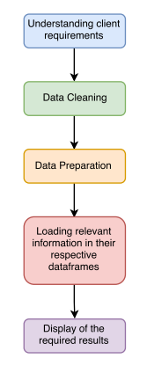
Problem solving methodology

Slide 4
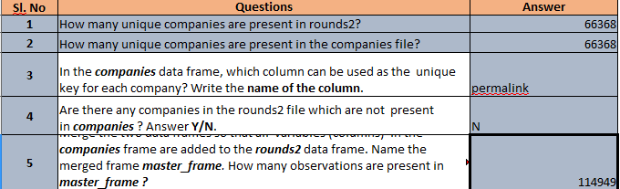
Analysis and Results

Slide 5
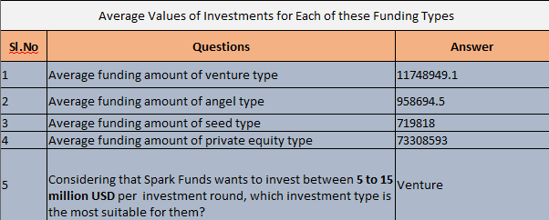
Analysis and Results

Slide 6
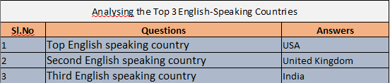
Analysis and Results

Slide 7
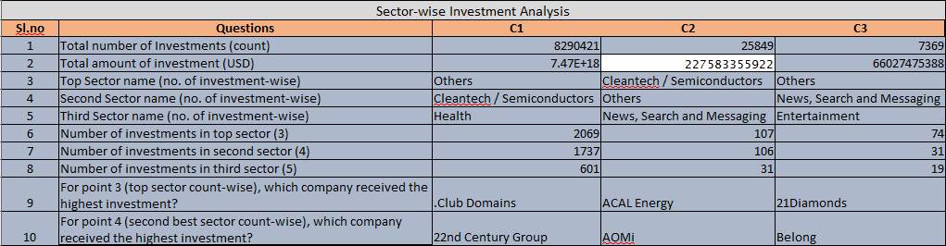
Analysis and Results

